Slide 1

Microservices - QUEUE
Fii Practic

Slide 2
Introduction
Recap
Web Api
Routes
Client
Inter process communication
Microservices
Queue
Communication using Message Queues

Slide 3
Communication
 | One-to-One | One-to-Many
Synchronous | Request/response | —
Asynchronous | Notification | Publish/subscribe
 | Request/async response | Publish/async responses

Slide 4
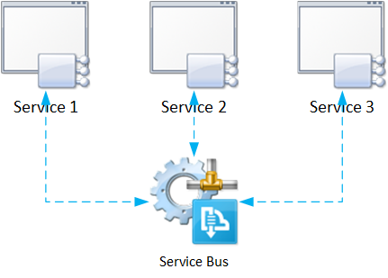
Introduction
insidethecpu.com
Microservice Architecture core concept

Slide 5
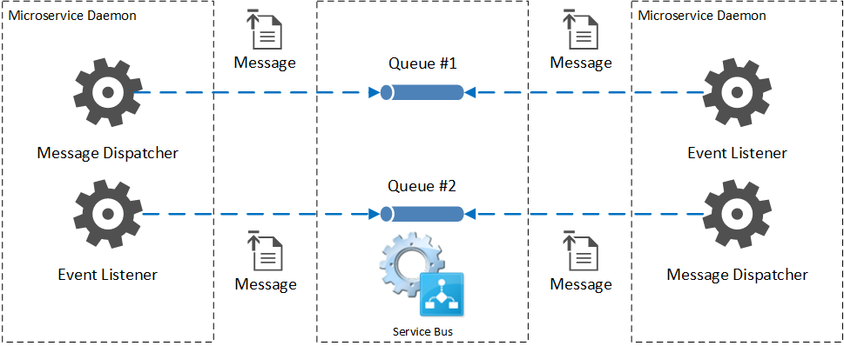
The QUEUE
insidethecpu.com

Slide 6
Prerequisites
RabbitMQ
https://www.rabbitmq.com/
Open source message broker software (sometimes called message-oriented middleware) that implements the Advanced Message Queuing Protocol (AMQP)
Advantages:
Robust messaging for applications
Easy to use
Runs on all major operating systems
Supports a huge number of developer platforms
Open source and commercially supported
RabbitMQ Client – NuGet package

Slide 7
DEMO

Slide 8

One Common Goal

